Slide 1

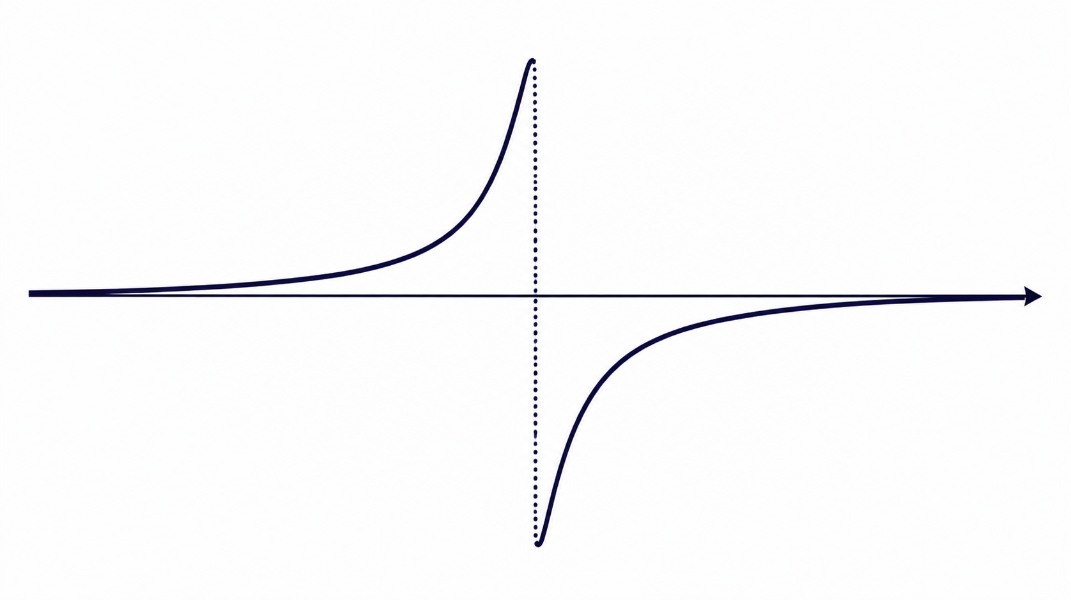


Amplitude-Robust Qubit Spectroscopy Using Echo-Root-Lorentzian Pulse Shapes
Asaf Solonnikov | Nadav Katz
Notes:
Good after noon, my name is Asaf. Today ill talk about amplitude-robust qubit spectroscopy using Echo Root-Lorentzian pulse shapes.

Slide 2

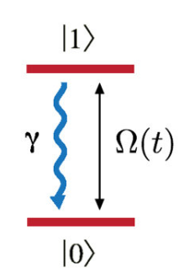

Spectroscopy for Precision Characterization of Two-Level Systems
Two-level systems appear in many physical platforms
Atomic transitions
Electron and nuclear spins
NV centers
Quantum dots
Superconducting qubits
Common goal
Determine the transition frequency
with the highest possible precision efficiently
Spectroscopy = frequency metrology
Notes:
Many quantum systems can be modeled as an effective two-level system, including atoms, spins, color centers, and superconducting qubits.
A fundamental task is determining the transition frequency as accurately as possible. This process is known as spectroscopy.
Spectroscopy is essentially a frequency metrology problem: we probe the system with different drive frequencies and observe its response.
The precision with which we estimate the transition frequency depends directly on the width of the resonance. A narrower resonance allows a more precise frequency estimate.
In this work, we focus on improving that current spectcopy methods

Slide 3
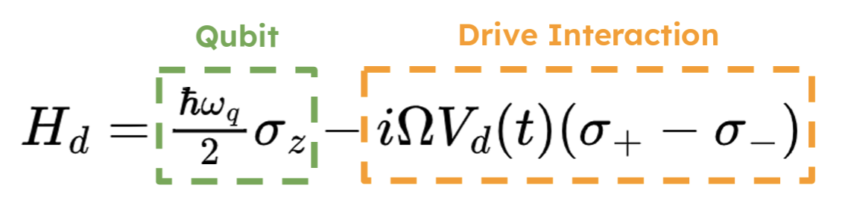
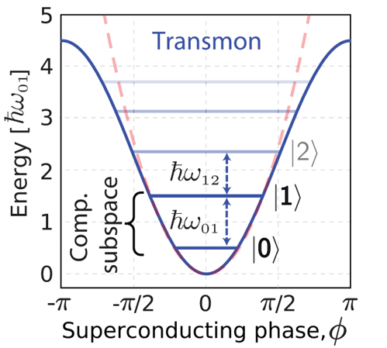
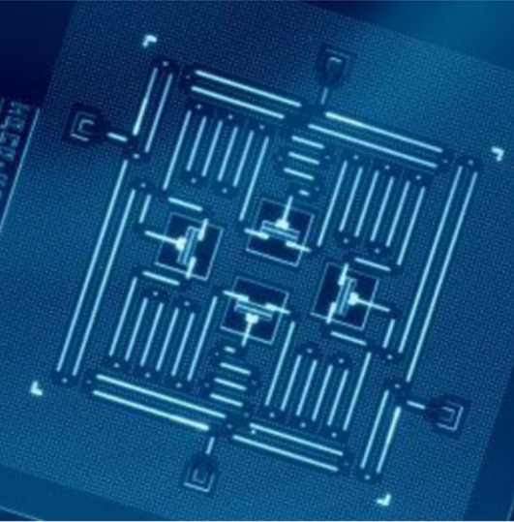
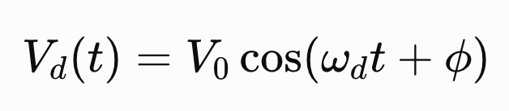
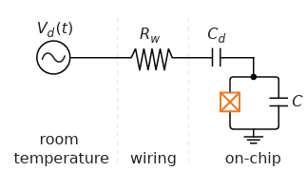
Superconducting Qubits
A transmon is a weakly anharmonic oscillator driven by resonant microwaves.
Notes:
A two-level system, or qubit, is characterized by its transition frequency, as shown in the Hamiltonian. To manipulate the qubit, we apply a microwave drive through a control line that is capacitively coupled to the circuit.
In this work, we use a transmon, one of the most widely used superconducting qubits. The transmon is a nonlinear quantum oscillator with unequally spaced energy levels. This anharmonicity allows us to isolate the two lowest energy levels and treat them as an effective two-level system.
Efficient control is achieved only when the drive frequency is resonant with the qubit transition frequency. Therefore, accurately determining this transition frequency is a fundamental prerequisite for high-fidelity quantum operations.

Slide 4
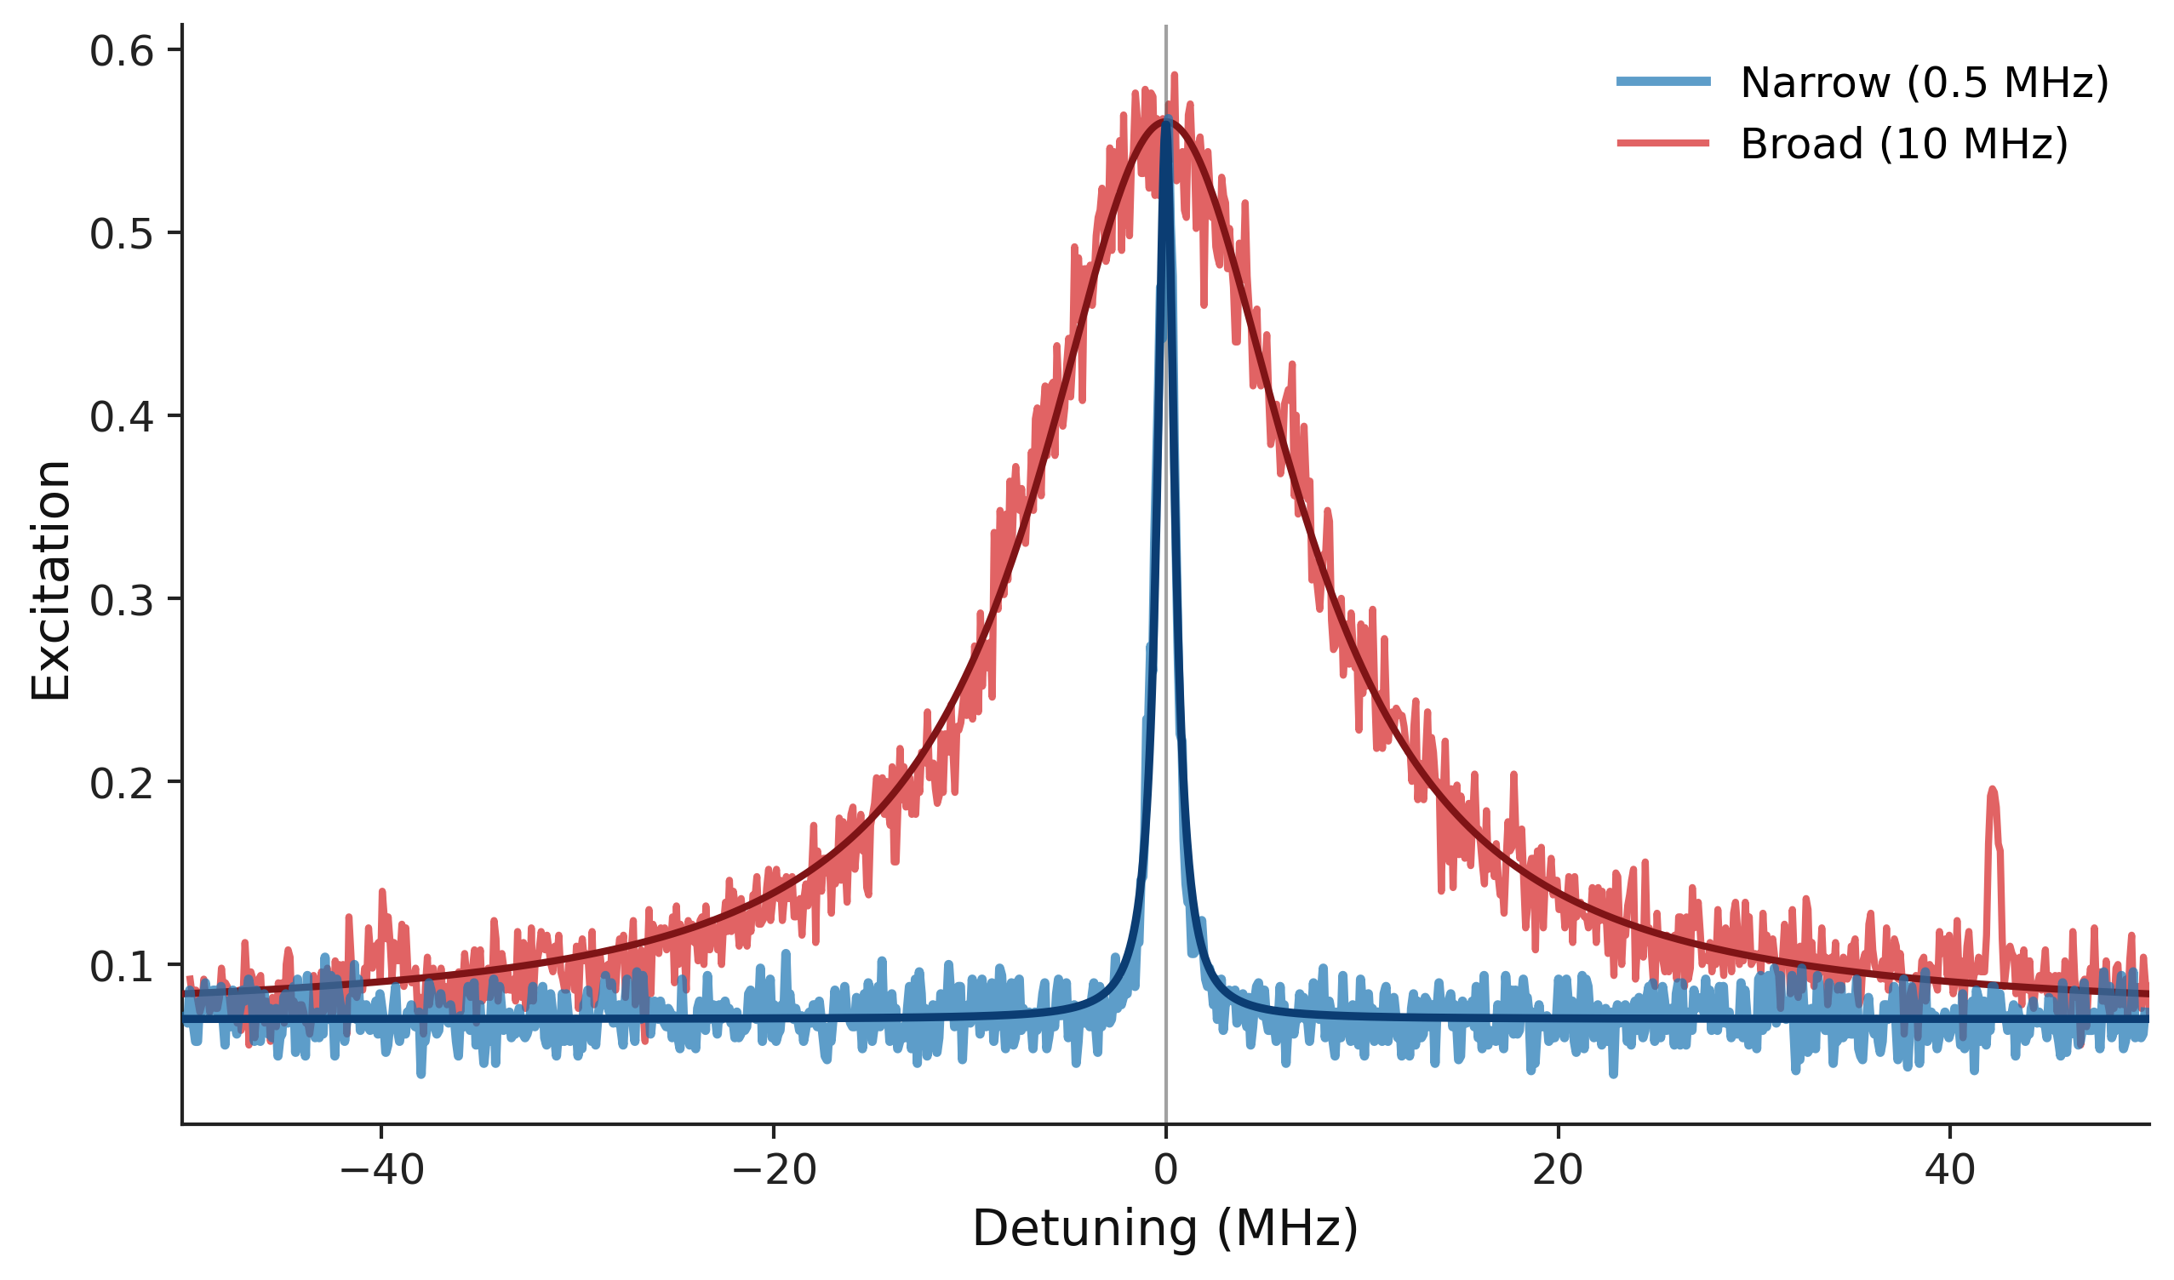
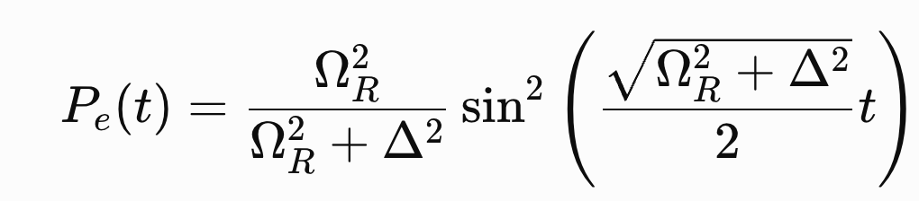
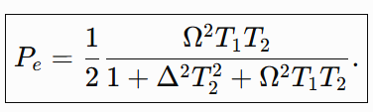
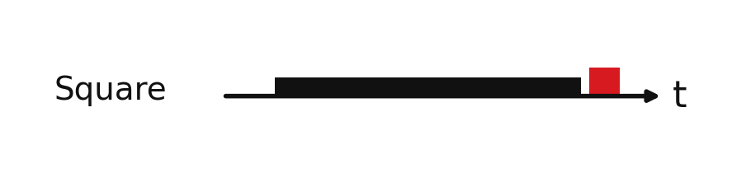
Motivation: Why Qubit Frequency Calibration Matters
High-fidelity quantum gates require an accurate estimate of the qubit transition frequency.
Increasing drive amplitude → ↑ SNR
but ↓ frequency resolution
Bloch equation:
Notes:
The probability of exciting the qubit is given by the Rabi formula shown on the left. It depends on two quantities: the detuning, which is the difference between the qubit frequency and the drive frequency, and the Rabi frequency, which is proportional to the drive amplitude. Also we have the blobh vecator which is fives the same result buit with Decay times and for very long pulse higher 10 Times T1
If we increase the drive amplitude, the qubit is easier to excite, giving a stronger signal and a better signal-to-noise ratio.
However, there is a drawback. As the drive becomes stronger, the resonance becomes wider, as shown in the spectroscopy map. This phenomenon is known as power broadening.
A broader resonance makes it harder to determine the exact center frequency. So we face a fundamental trade-off: strong drives provide better SNR, while weak drives provide better frequency resolution.

Slide 5
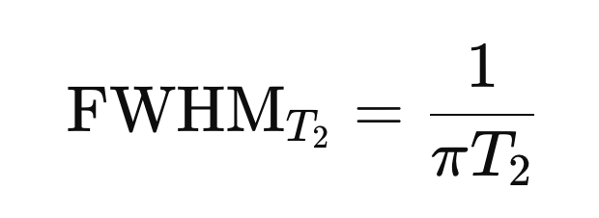

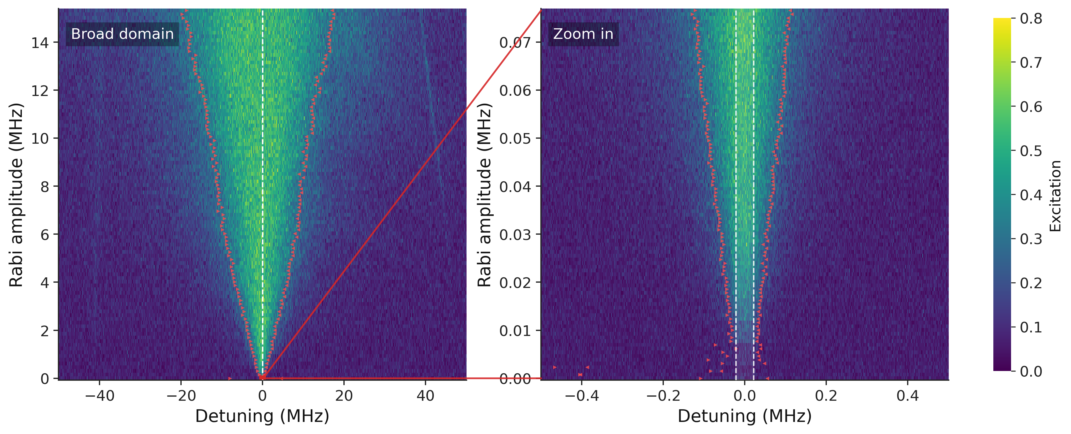
High-Resolution Qubit Spectroscopy Under Strong Driving
We cannot perform precise frequency estimation when the drive is strong
Spectroscopy linewidth is fundamentally limited by coherence time
Notes:
Here we show the same effect in a 2D scan by sweeping both the drive detuning and amplitude.
At high amplitudes, the linewidth increases linearly due to power broadening.
At low amplitudes, the linewidth saturates at the (T_2) limit, but the signal becomes weak, reducing the signal-to-noise ratio.
This highlights the trade-off between spectral resolution and SNR in conventional spectroscopy.

Slide 6
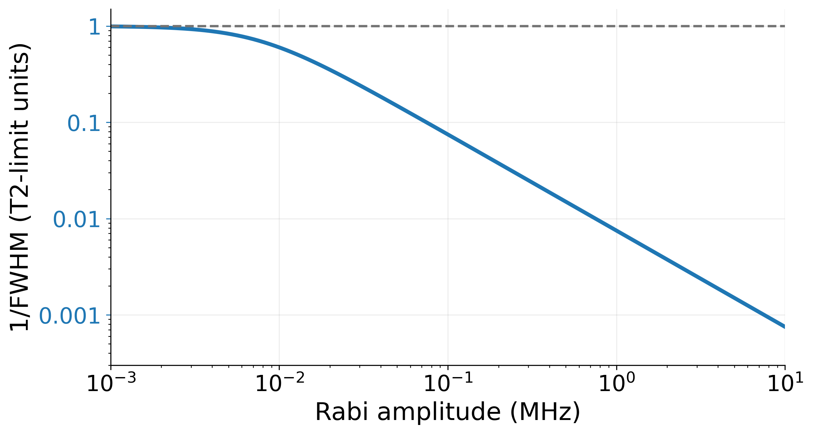
Frequency calibration needs resolution without fragile low-amplitude scans
Notes:
Here we plot the frequency resolution, which scales approximately as 1/ FWHM As expected, in the low-amplitude limit the linewidth approaches the (T_2)-limited resolution.

Slide 7
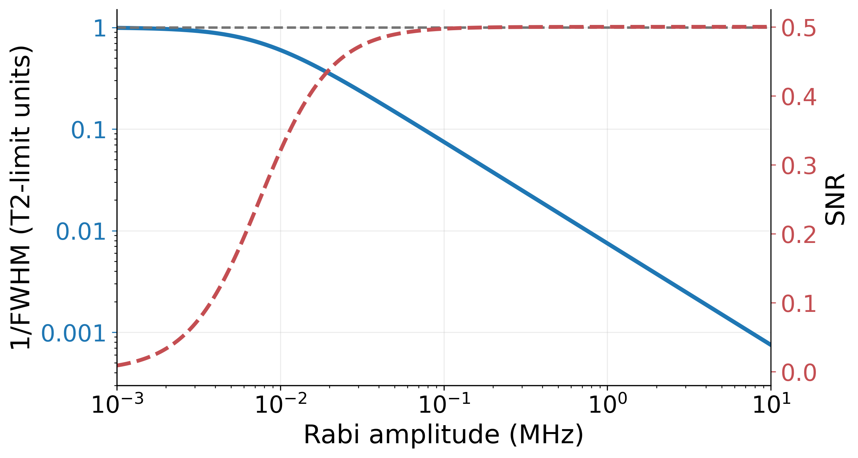
Frequency calibration needs resolution without fragile low-amplitude scans
Notes:
On the same plot, we can also show the signal-to-noise ratio. The problem is that resolution improves at low amplitude, while SNR improves at high amplitude.

Slide 8
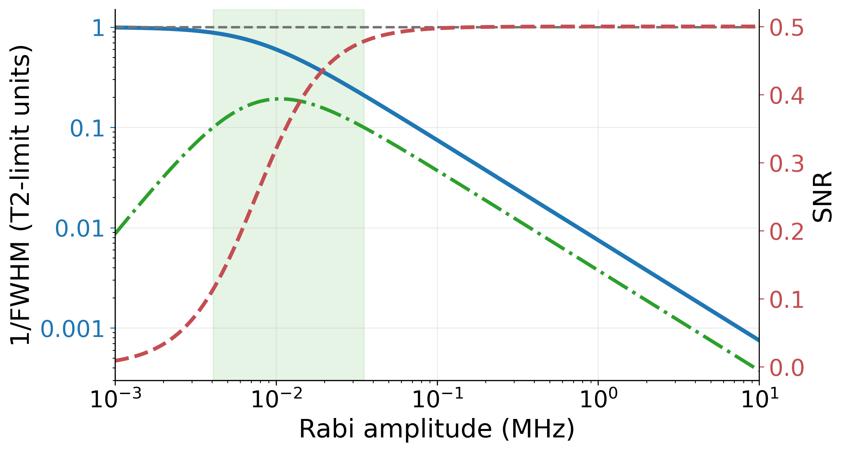
Frequency calibration needs resolution without fragile low-amplitude scans
Notes:
Therefore, the amplitude range where both resolution and SNR are good is very narrow. This makes conventional spectroscopy fragile and often requires repeated scans to find the optimal amplitude.

Slide 9
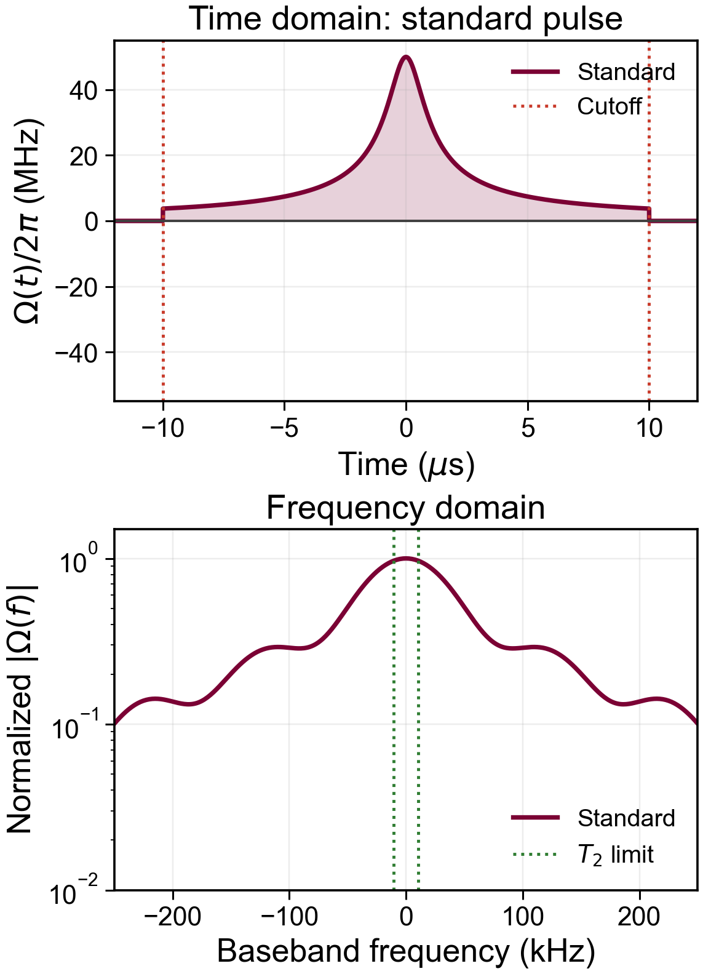
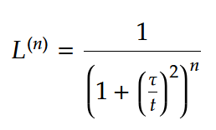
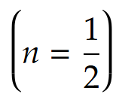
Power narrowing
Ordered Lorentzian pulse
We focus on the root Lorentzian pulse
Lorentzian pulse shapes can exhibit power narrowing!
Defying Conventional Wisdom in Spectroscopy: Power Narrowing on IBM Quantum Ivo S. Mihov and Nikolay V. Vitanov 2023
Notes:
To overcome power broadening, we explore a different pulse shape instead of the conventional square pulse.
Previous work by Mihov and Vitanov showed that root-Lorentzian pulses can exhibit power narrowing, where the resonance becomes narrower rather than broader as the drive amplitude increases. This behavior is related to the pulse's adiabatic properties.
However, Lorentzian pulses are theoretically infinite in time, so in practice they must be truncated. In addition, the previous work focused on relatively short pulses and therefore did not reach the ultra-high-resolution regime.
Our approach has two key innovations. First, we use long-duration root-Lorentzian pulses, allowing us to approach the coherence limit. Second, we introduce an echo-root-Lorentzian by changing the sign of the pulse exactly at its midpoint.
This phase reversal acts like a Loschmidt echo: it suppresses coherent oscillations and creates a spectral null at the drive frequency, while preserving the narrow resonance. As we'll see in the next slides, this dramatically improves the robustness of spectroscopy.

Slide 10
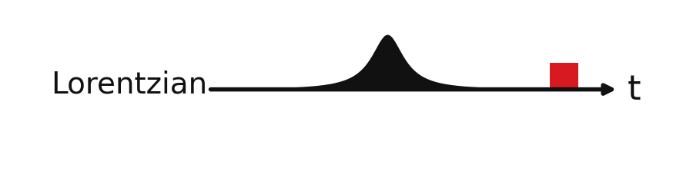
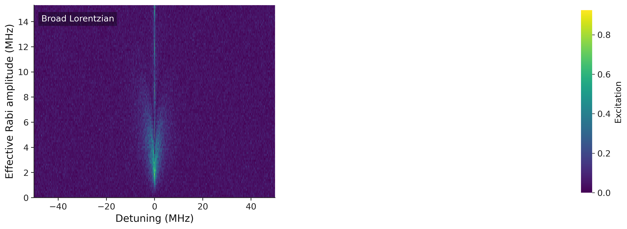
Root-Lorentzian Pulse Shape
L = 20 us, cutoff = 0.005
Notes:
Let us start by examining the root-Lorentzian pulse. First, we compare its spectrum with that of the conventional square pulse over the same frequency range.
At first glance, the root-Lorentzian already produces a much narrower resonance while maintaining a strong excitation probability.

Slide 11
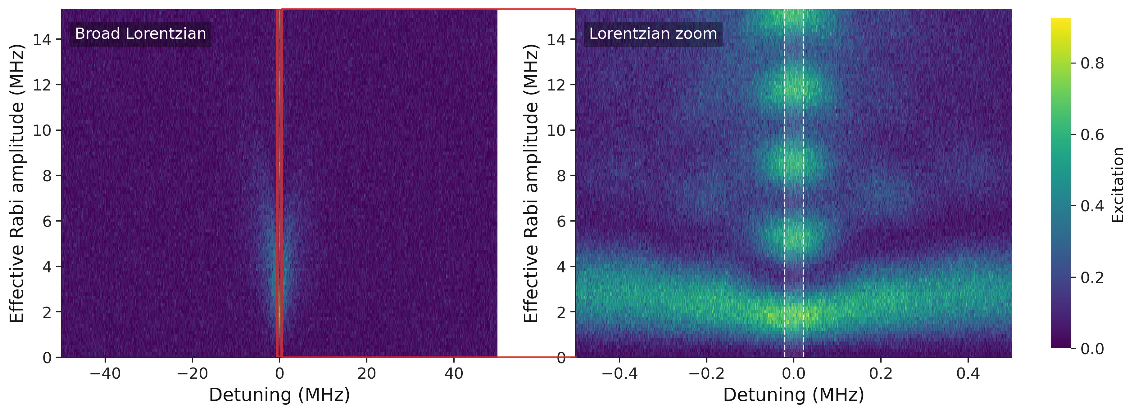
Root-Lorentzian Pulse Shape
L = 20 us, cutoff = 0.005
Notes:
If we now zoom into a 1 MHz frequency span, the difference becomes even more apparent. We see that the root-Lorentzian generates an extremely narrow resonance, but it also exhibits pronounced oscillatory side lobes.

Slide 12
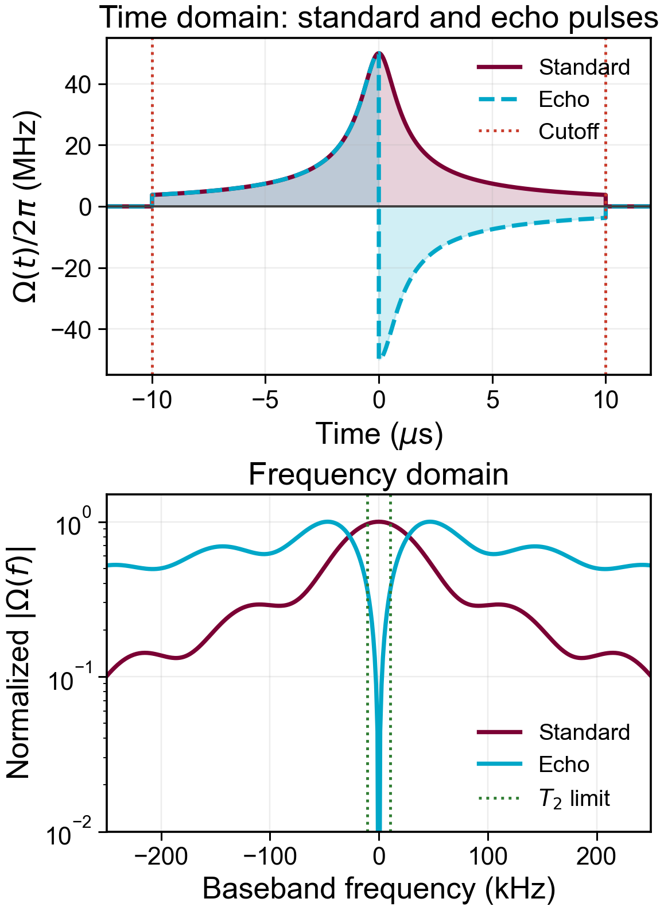

Echo-Root-Lorentzian
We introduce an echo-root-Lorentzian, obtained by changing the pulse sign at its center:
Have zero power on the drive frequency
Cancel coherent oscillations
Inspired by:
Loschmidt echo
STED microscopy Stefan Hell
Notes:
Latly there is intersrit in types of pulse sthat generate pwower narrwogn whaich is the opposite intersing phinmona. Due to intersitng adioabatic property imprt to ad the thses pulse are infint and hence need to be cutted A paper by Mihov and Vitanov shown that the power narrwojng effect on quboits but for short pulses. They uses the lornetizn as pulse And hemse not entring the ultra high rsultiomn. Our novelty is first incraes the pulse length and also To overcome the power broadening, we explore an alternative pulse shape instead of the conventional square pulse.
We focus on the root Lorentzian pulse, shown here. Previous work has shown that Lorentzian pulses can exhibit power narrowing, meaning that under the right conditions the resonance can become narrower rather than broader as the drive strength increases.
Our main contribution is introducing an echo version of this pulse. The pulse envelope remains the same, but its sign changes exactly at the center, corresponding to a π phase flip during the pulse.
This simple modification turns out to significantly improve the spectroscopy performance, as I'll show in the following results.

Slide 13
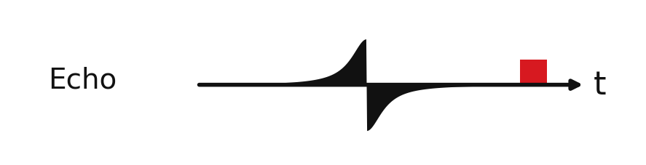
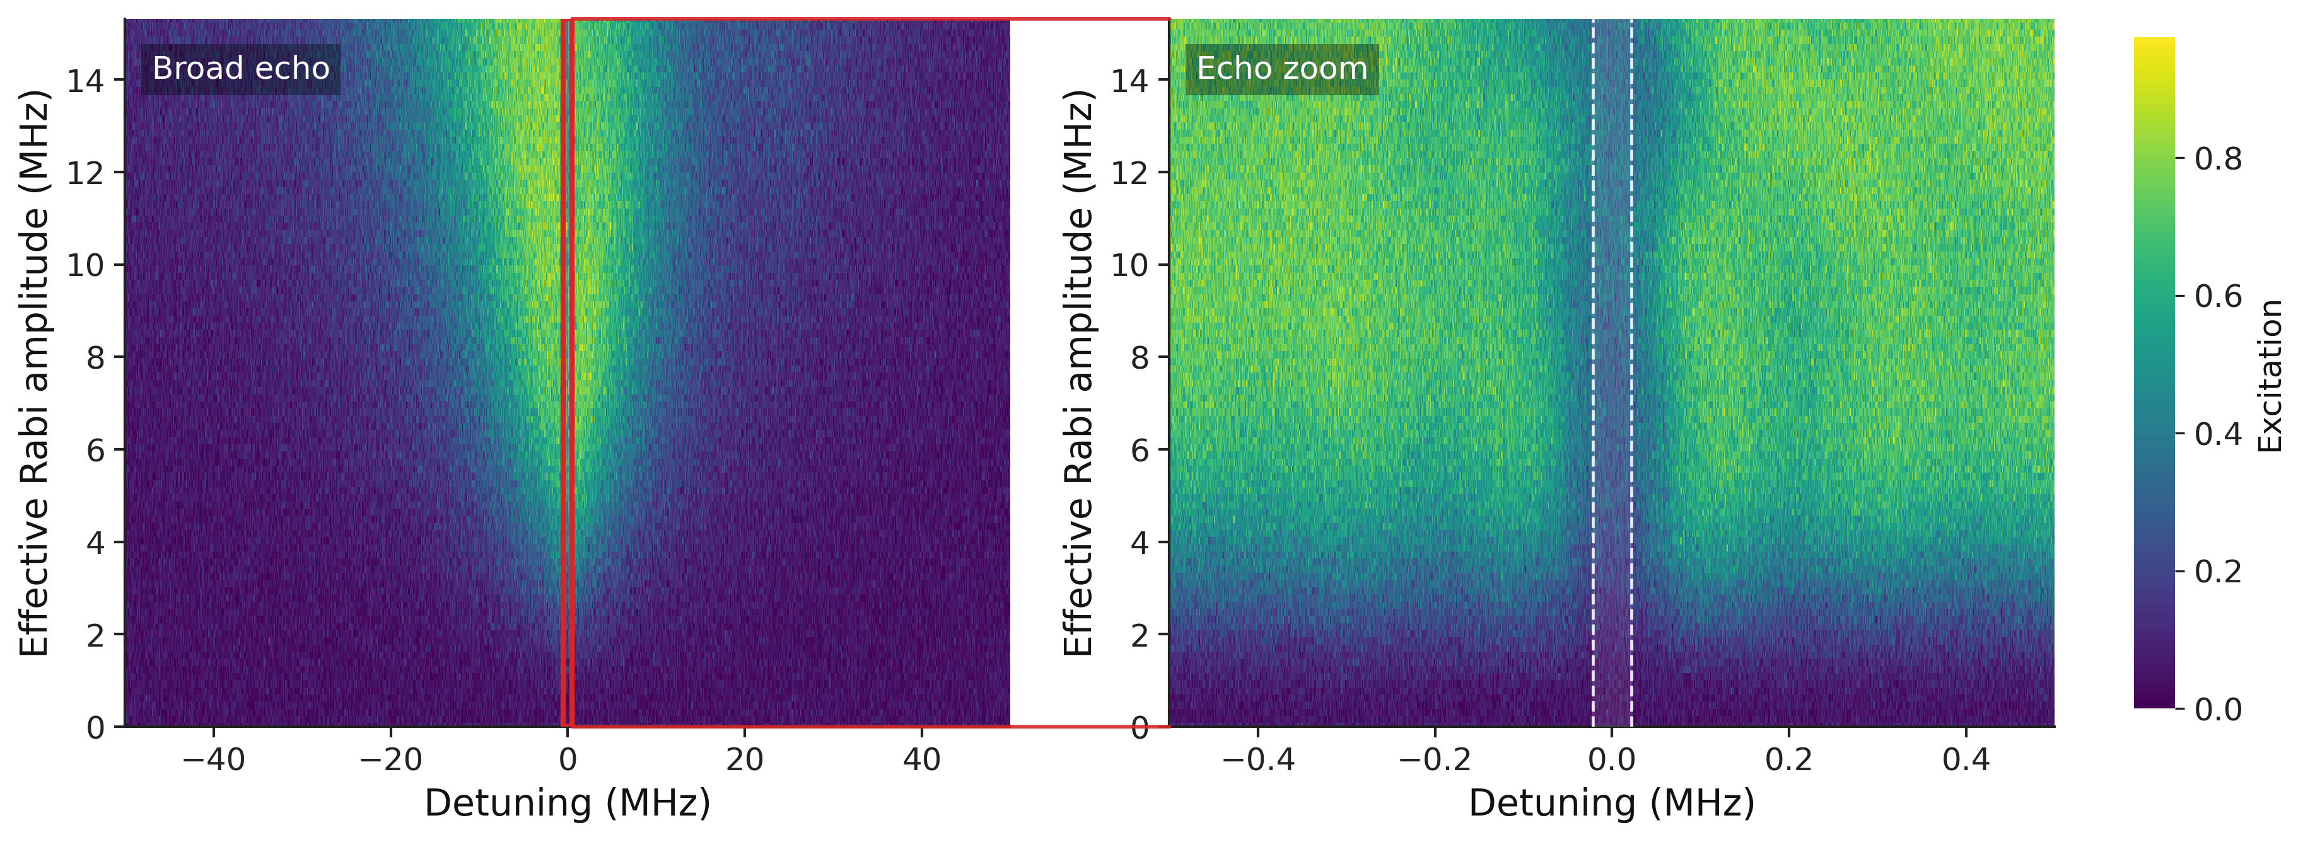
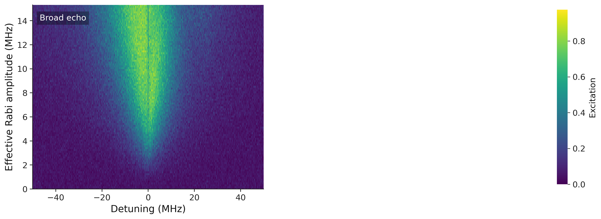
Echo-Root-Lorentzian Results
L = 20 us, cutoff = 0.005

Slide 14
Echo-Root-Lorentzian Results
L = 20 us, cutoff = 0.005
The second half reverses the coherent evolution of off-resonant components, like a Loschmidt echo, while preserving a sharp resonant response.

Slide 15
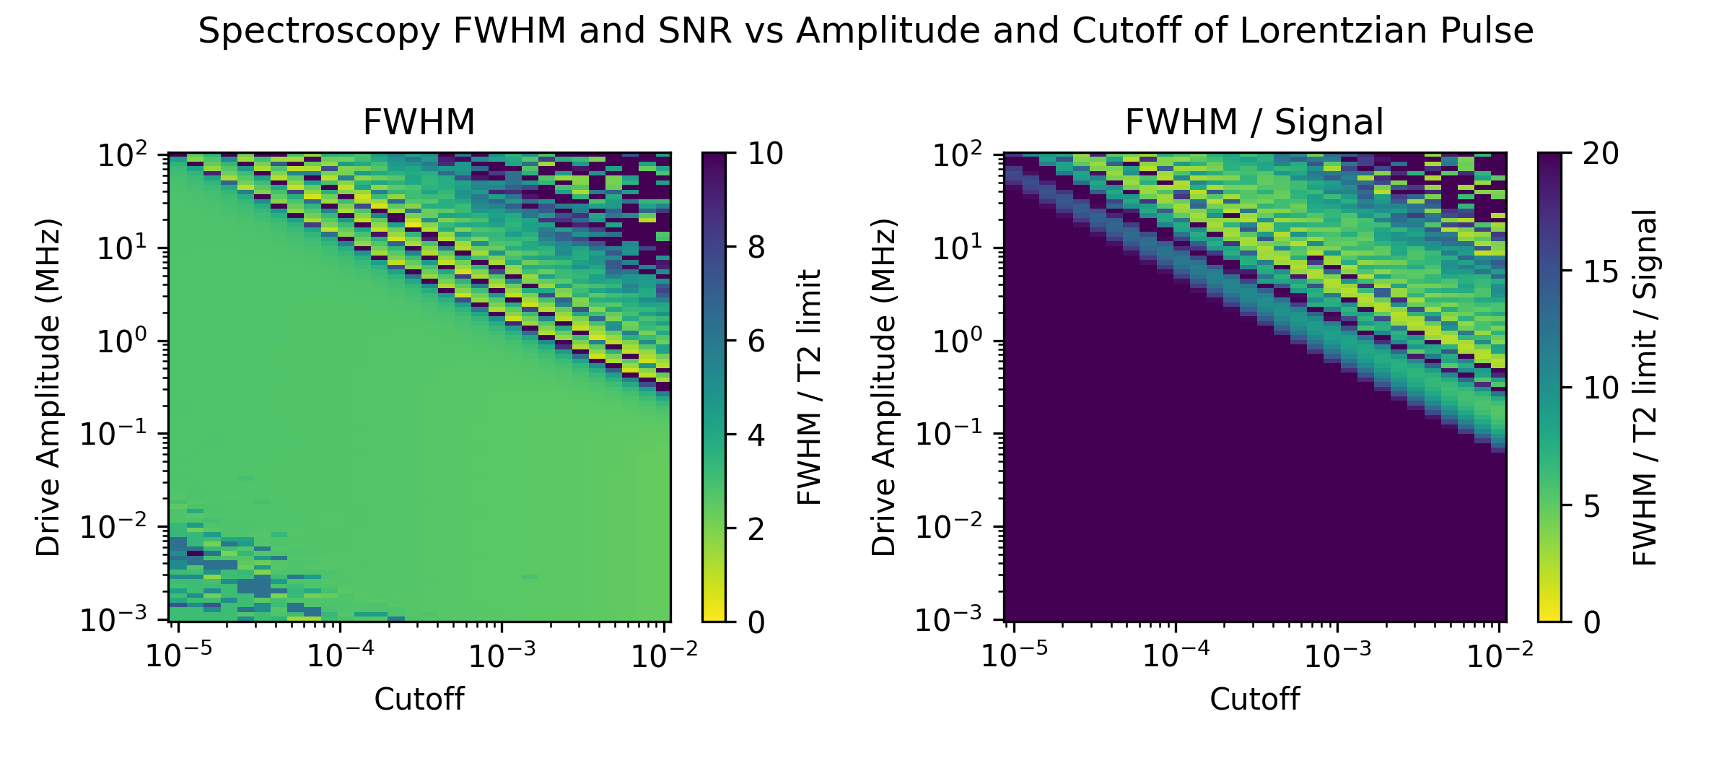
Robustness
Notes:
Here I repeated the same scan for the regular Lorentzian pulse.
Unlike the echo pulse, the linewidth increases much earlier with drive amplitude and shows oscillatory regions due to the pulse dynamics. The optimal region is therefore much smaller and more sensitive to the choice of cutoff.
The takeaway is that the standard Lorentzian is much less robust, requiring careful tuning of both amplitude and cutoff to maintain a narrow linewidth and good signal.

Slide 16
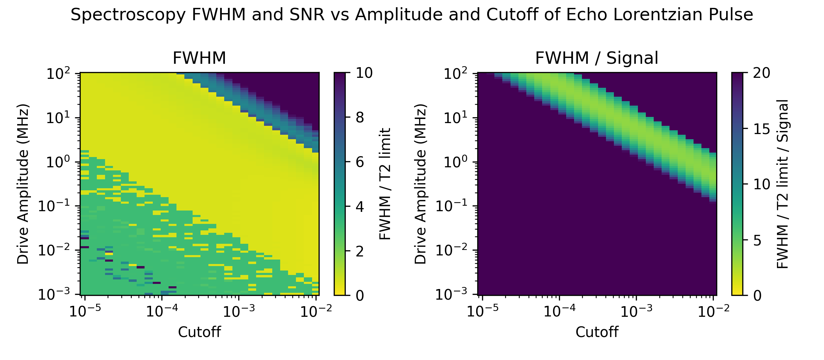
Robustness
Notes:
Here I scanned the drive amplitude and the cutoff of the echo-Lorentzian pulse.
The left panel shows the linewidth normalized to the $T_{2}$limit. For low and moderate amplitudes, the linewidth stays close to the $T_{2}$limit over a wide range of cutoffs. At higher amplitudes, power broadening appears, but increasing the cutoff pushes this transition to higher powers.
The right panel includes the signal. The diagonal band marks the optimal operating region, where we achieve both near-$T_{2}$-limited resolution and strong signal.
The takeaway is that the cutoff is an important optimization parameter, allowing us to use higher drive powers without sacrificing spectral resolution.

Slide 17
Questions?

Slide 18
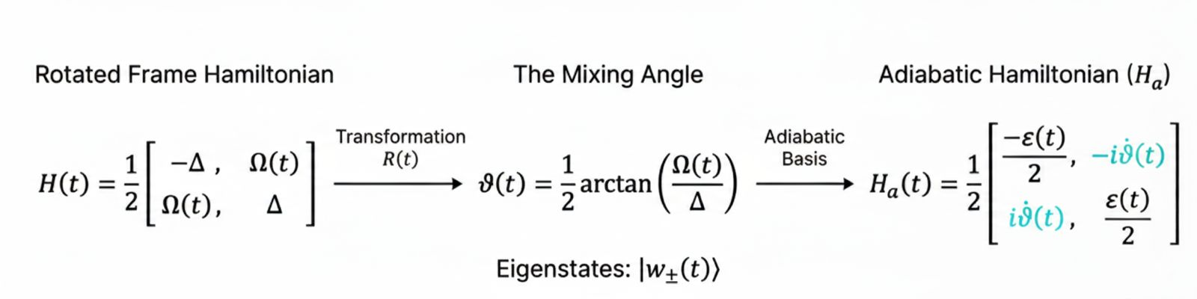


Pulse shaping can change the spectroscopic response
Adiabatic condition
The adiabatic approximation requires
or equivalently,
Defying Conventional Wisdom in Spectroscopy: Power Narrowing on IBM Quantum Ivo S. Mihov and Nikolay V. Vitanov Phys. Rev. Lett. 132, 020802 (2024)

Slide 19


Power narrowing
If we shape power law tails to our pulse
then solving the boundary of the nonadiabatic region yields
Defying Conventional Wisdom in Spectroscopy: Power Narrowing on IBM Quantum Ivo S. Mihov and Nikolay V. Vitanov Phys. Rev. Lett. 132, 020802 (2024)

